Slide 1








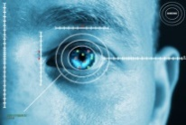
Best Practices from Top Outsourced Cities & Regions
Outsource2LAC 2017
Architecting Resilience
Digital Trust
Active Defense
Intelligent Enterprise
Intelligent Automation
Digital Physical Blur
Platform Revolution
March 2017

Slide 2
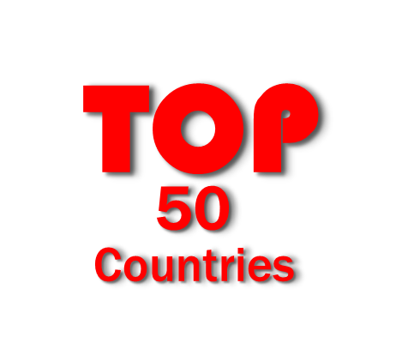
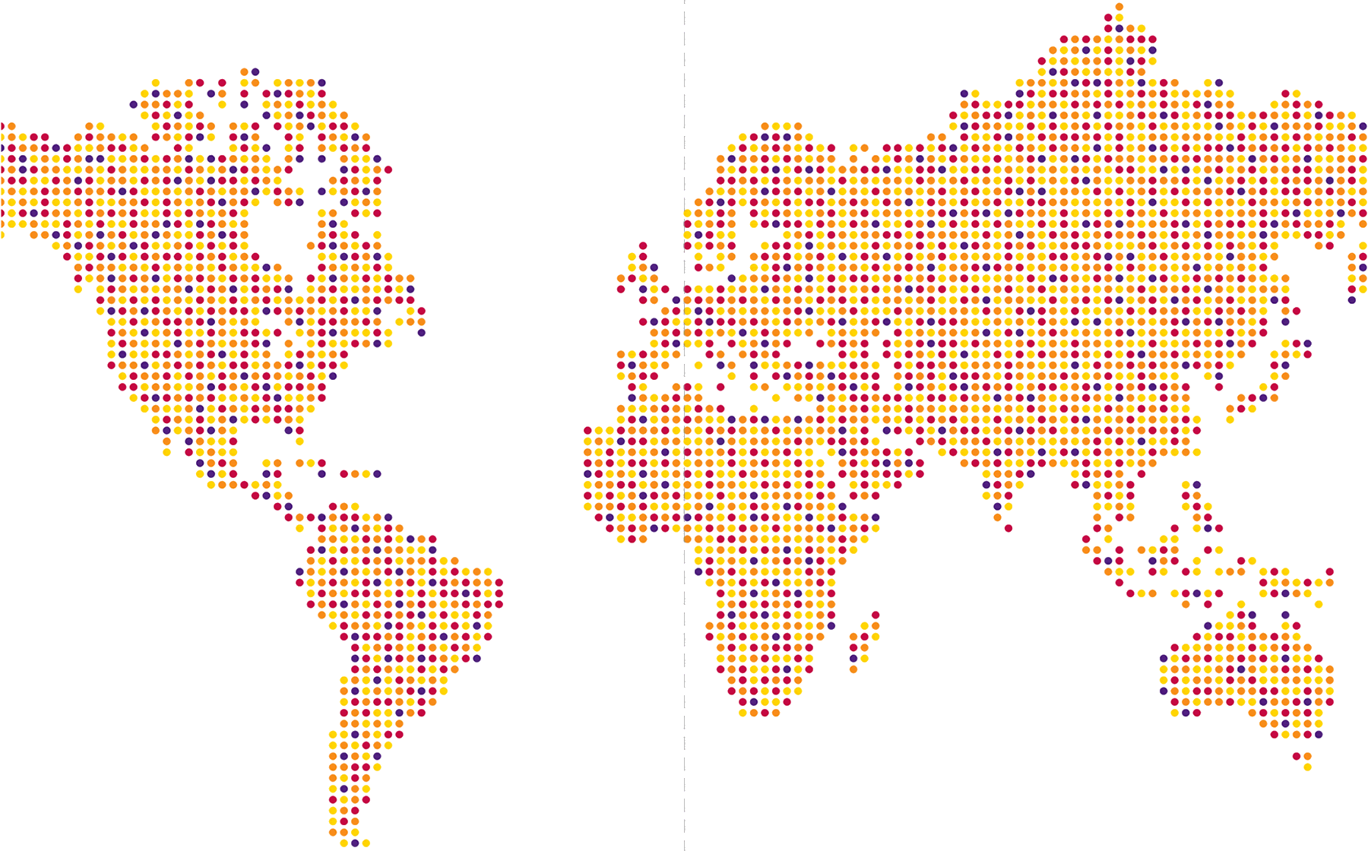

Country Ranking Framework
OVERALL
DIGITAL
Component | Weightage
Workforce Population | 20%
Super Cities | 20%
Innovation / Digital | 18%
Talent, Skills & Quality | 12%
Cost | 12%
Risk & Quality of Life | 6%
Business Catalyst | 6%
Infrastructure | 6%
Component | Weightage
Number of Startups | 30%
Open Innovation Ecosystem | 20%
Startup Diversity & Maturity | 20%
Innovation Policy / Incentives | 20%
Unicorns | 10%

Slide 3



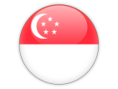
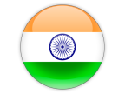

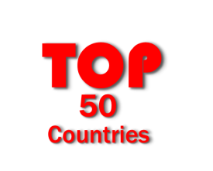
Digital Nations: Tholons Services Globalization Index 2017
THOLONS TOP 10 COUNTRIES
THOLONS TOP 5 DIGITAL NATIONS
ISRAEL
CANADA
SINGAPORE
INDIA
BRAZIL
Rank | Countries
1 | India
2 | China
3 | Philippines
4 | Brazil
5 | Mexico
6 | Canada
7 | Chile
8 | Vietnam
9 | Poland
10 | Russia
Notes:
Canada, Chile, Russia have come into Top 10 Countries

Slide 4











Super Cities: Tholons Services Globalization Index 2017
THOLONS TOP 10 CITIES
THOLONS TOP 10 SUPER CITITES - DIGITAL
Rank | Cities | Country
1 | Bangalore | India
2 | Mumbai | India
3 | Delhi (NCR) | India
4 | Manila (NCR) | Philippines
5 | Hyderabad | India
6 | Sao Paulo | Brazil
7 | Dublin | Ireland
8 | Krakow | Poland
9 | Shanghai | China
10 | Chennai | India
TEL AVIV - Israel
SAO PAULO - Brazil
BANGALORE - India
MUMBAI - India
SEOUL – South Korea
SINGAPORE – Singapore
VANCOUVER – Canada
DELHI (NCR) – India
SHANGHAI – China
TORONTO - Canada
Notes:
Sao Paulo and Shanghai have come into Top 10 Cities

Slide 5
Leaders are stumbling!
Americas have accelerated tremendously. Canadian cities like Toronto and Vancouver have improved their ranking. Sao Paulo has come into Top 10, Santiago has made significant improvement in its ranking
What cities/countries have to do to remain as leaders and/or establish themselves as leaders..
Governments have to align training programmes and funding to promote innovation, start-ups and digital transformation of industries.
Give importance to Start-ups, Industries and private enterprises that focus on big data analytics, data forecasting and simulation etc.
Top Break-ins
Top Move-outs
Canada, Chile and Russia
Sao Paulo, Shanghai
Czech Republic, Ireland and Sri Lanka
Pune, Cebu

Slide 6





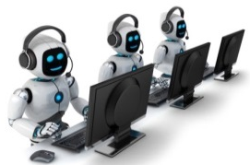



Key Technology and Business Trends 2016-2020 (Workforce & Disrupters)
Workforce
Reimagined
Design for Analytics to Get the “Right” Data
Take Advantage of Data “Velocity”
Automation
Robotics
Data Supply Chain
Architecting Resilience
Digital Trust
Active Defense
Cognitive Computing
From Workforce to
Crowd Source
Artificial Intelligence
Liquid
Workforces
Intelligent Enterprise
Intelligent Automation
Digital Physical Blur
Platform Revolution
Cloud
Business
of
Apps
Create Digital Network at Scale
Internet
of
Me

Slide 7




Intelligent Sourcing, Mobility Enabled Employees and Extended Workforce
Job / Candidate Search
Interviews
Competency / Fit Assessment
Mobile Onboarding, Learning
& Engagement
Time, Leave & Expense Management

Slide 8









































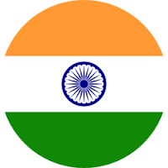




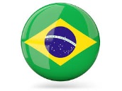













Tholons Global Digital / Innovation Network
GO TO MARKET CLIENTS
GLOBAL NETWORK OF STARTUPS
CIRCLE OF MENTORS
PLATFORM BUILDERS
FUNDING
Mentors with big corporation and entrepreneurship experience
Client Partners
STRATEGIC PARTNERS
1200
1100
1050
500

Slide 9
Contact
Avinash Vashistha
Chairman & CEO
vashistha.av@gmail.com
avinash@tholons.com
M: +1-646-250-3828 | +1-646-875-4945
North America Suite 205, 46 W. Julian Street San Jose, CA 95110 415 Madison Avenue, 14th Floor New York, NY 10017 USA | Europe 2505 The Landmark West Tower 22 Marsh Wall, London E14 9AL United kingdom | India 346, 17th Cross HIG / Dollars Colony Bangalore 560 094
Singapore 120, Lower Delta Road #05-14, Cendex Centre Singapore 169 208 | Philippines Unit 803, Richmonde Plaza 21 San Miguel Avenue, Ortigas Center, Pasig City 1600, Metro Manila, Philippines | South America Luis Bonavita 1294 Of. 216 11300 Montevideo Uruguay

